Slide 1
Category review: Chips
June 2020
Retail Analytics
Brand note: If client logo is not required, use alternate title page layout right click slide thumbnail > Layout > Title

Slide 2
Notes:
To view Privacy video explaining how important data privacy is to Quantium, please click here: https://www.youtube.com/watch?v=Zq1QDAkoRzU
or here Q:\Company Reference\Brand & Design\Brand videos\Q Privacy.mp4
At Quantium, we believe that data is the behavioural footprint of humanity and that it has to be treated with the utmost care and responsibility.
Histories, attitudes, indeed lives are stored within it in ways that aren’t always apparent – and that’s what makes its potential so powerful.
To work with it responsibly, sensitively, we set ourselves the highest data privacy protection and governance standards.
We have spent 17 years perfecting privacy-by-design and secure-by-design principles. Central to this is not holding any personally identifiable information about people –
we neither receive it, and put the necessary protections in place to be unable to decipher it.
Every aspect of handling data is safeguarded: from its de-identification, to its encryption – data security is paramount and of the highest grade.
We pride ourselves on gaining the trust of iconic organisations around the world through years of securely working with their data,
and in turn the trust that builds with their stakeholders.

Slide 3
Executive summary
01
Task 1
Here you will include your high-level findings and any key callouts for task 1
02
Task 2
Here you will include your high-level findings and any key callouts for task 2

Slide 4
01
Category

Slide 5
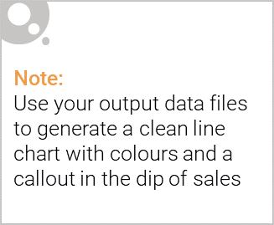
Overview:
Sales have mainly been due to Budget - older families, Mainstream young singles/couples, and Mainstream - retirees shoppers. We found that the high spend in chips for mainstream young singles/couples and retirees is due to there being more of them than other buyers. Mainstream, mid-age and young singles and couples are also more likely to pay more per packet of chips. This is indicative of impulse buying behavior.
We’ve also found that Mainstream young singles and couples are 23% more likely to purchase Tyrrells chips compared to the rest of the population. The Category Manager may want to increase the category’s performance by off-locating some Tyrrells and smaller packs of chips in discretionary space near segments where young singles and couples frequent more often to increase visibility and impulse behavior.
Quantium can help the Category Manager with recommendations of where these segments are and further help them with measuring the impact of the changed placement.

Slide 6

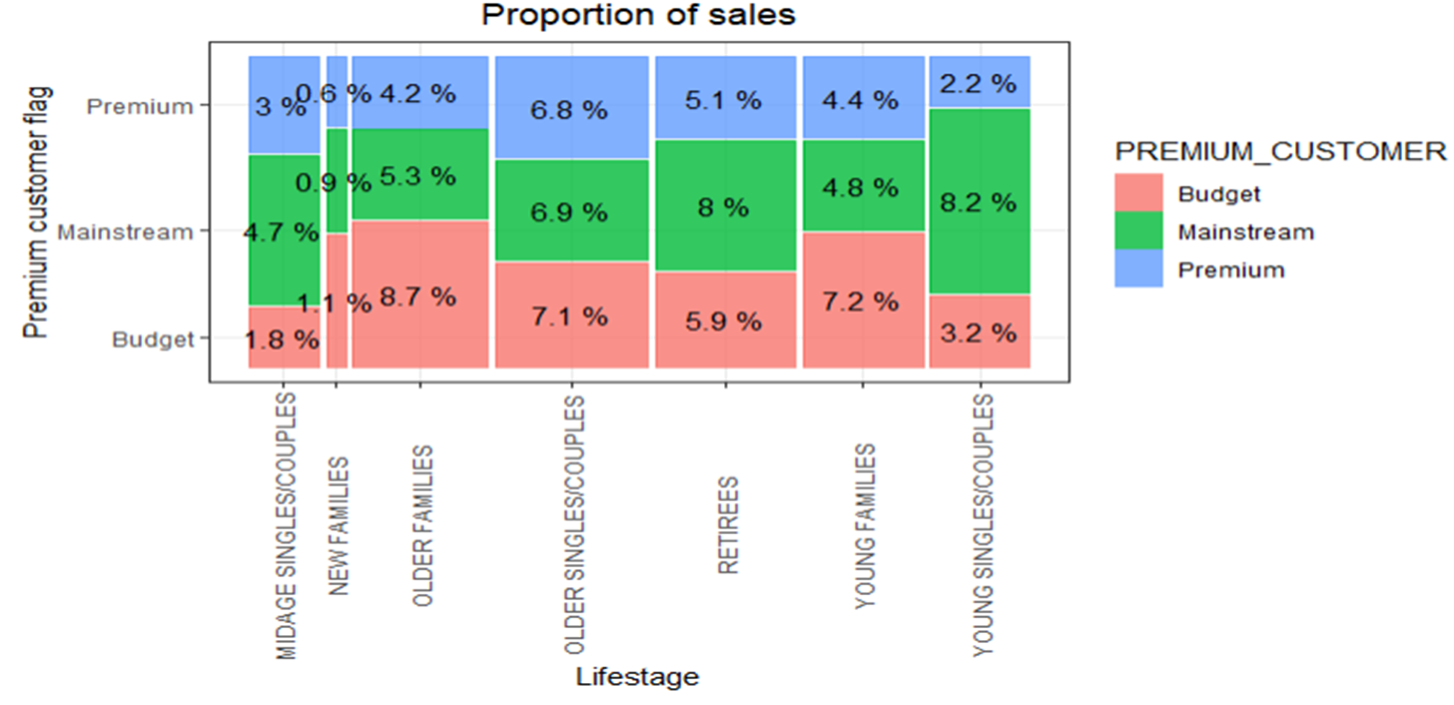
Affluence and its effect on consumer buying for the category of chips

Slide 7
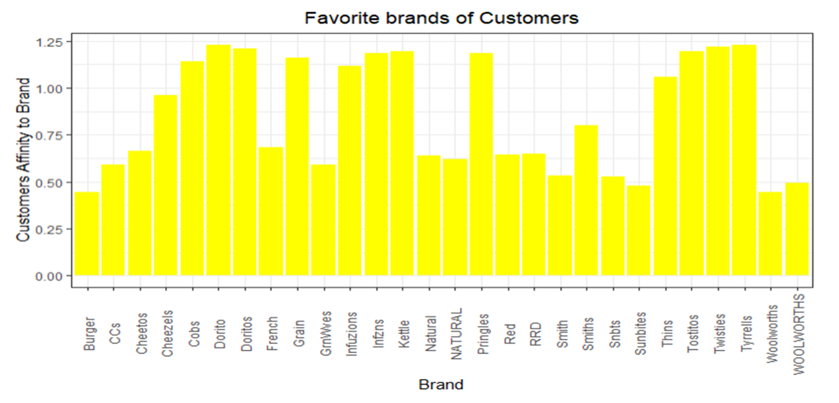
Brand Insights

Slide 8
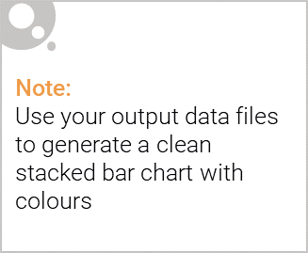
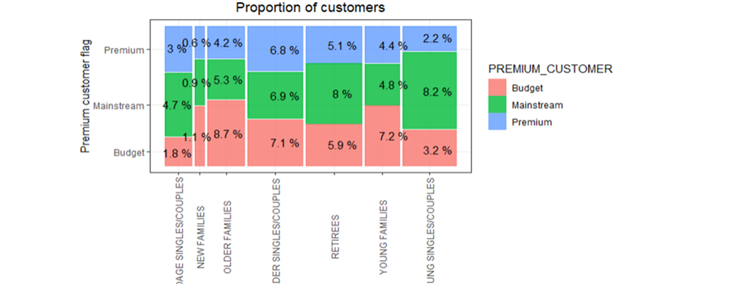
Editable (delete this)
Proportion Of Customers By Affluence And Life Stage

Slide 9
02
Trial store performance

Slide 10
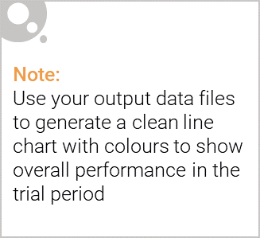
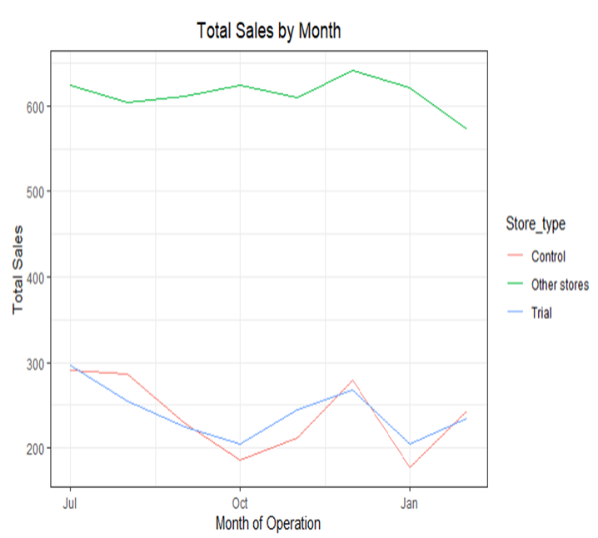
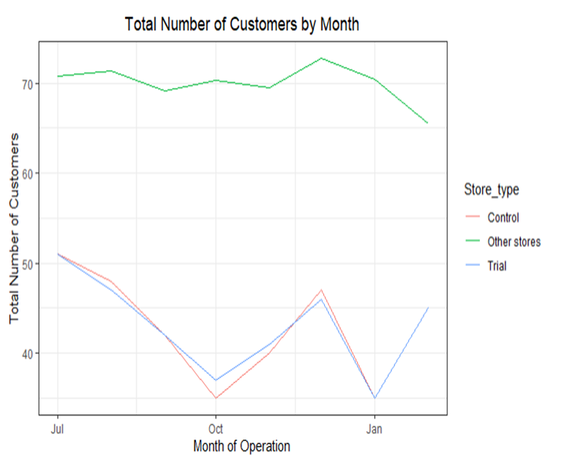
Control Store Vs Other Stores

Slide 11
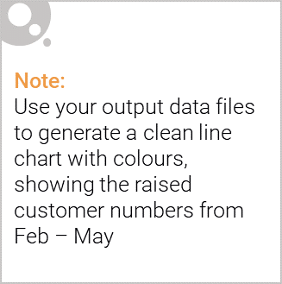
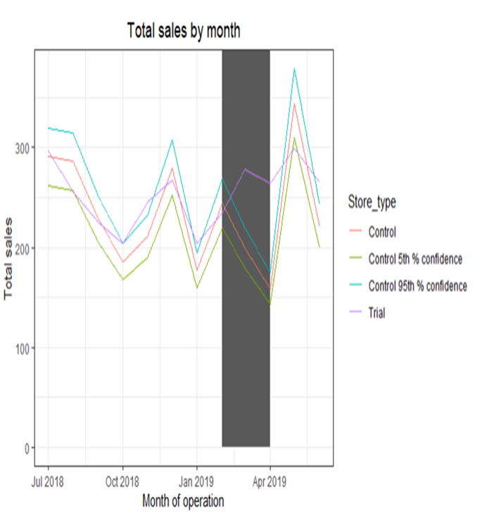
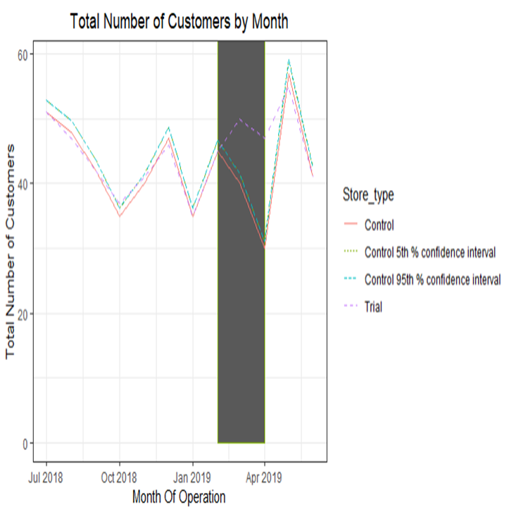
Performance In The Trial Store

